Slide 1
Election Analytica
Project Report Submission
on
By Pranjal Rastogi
CSE-2 (M)
05215002716 (25)

Slide 2
Introduction
Analyze previous Vidhan Sabha election .
Judging census parameters with voting pattern for each party/candidate
The analysis has been done for Guhla, Kaithal, Kalayat constituencies in Kaithal District, Haryana

Slide 3
About
The project comes under banner of Data Analysis and consists of following steps:
Collection of data from trusted sources
Wrangling of data in proper format
Cleaning of data
Visualization of data over recorded parameters
Modeling and algorithms
Deriving conclusions and results

Slide 4
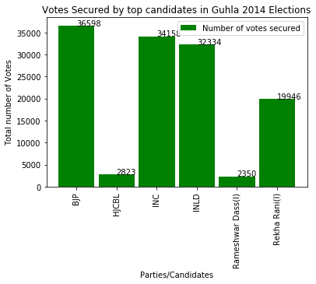
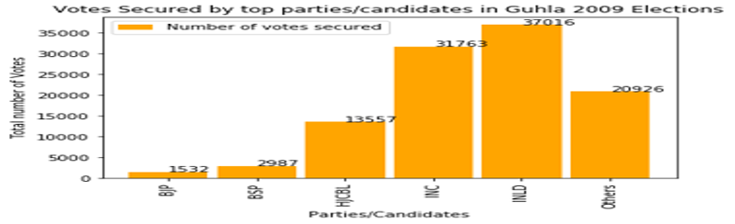

Slide 5
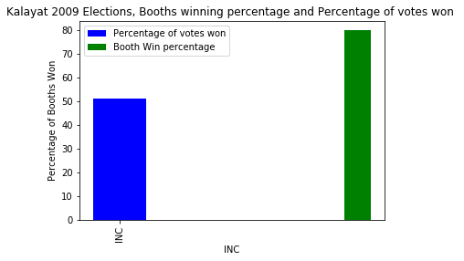
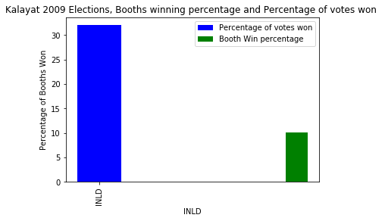
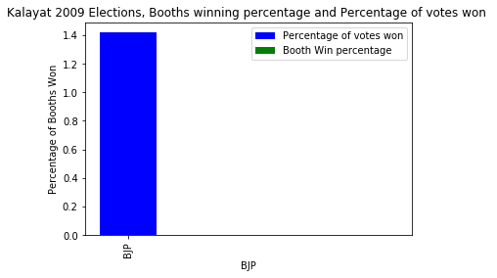
INC won highest number of booths as well as their booth win percentage is very high but INLD even though got large vote percentage could no secure lots of booths. BJP also got more vote percentage but zero booth win percentage. This shows that INC has strong voter's base in Kalayat Constituency .

Slide 6
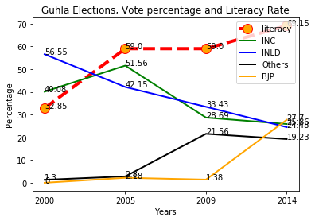
With rise in Literacy rate over the years, the voting percentage has become similar for each party. The literate population now cast it’s vote on basis of agendas that suits them and not under influence of economic and political status of candidate .

Slide 7
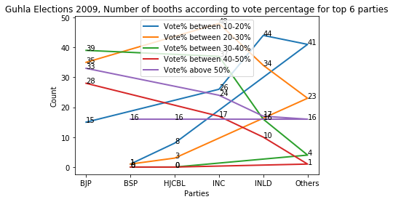
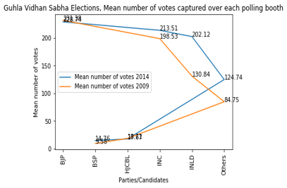

Slide 8
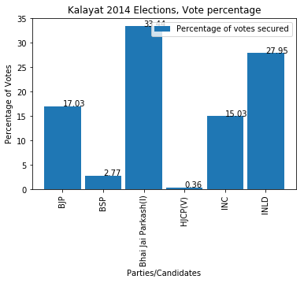
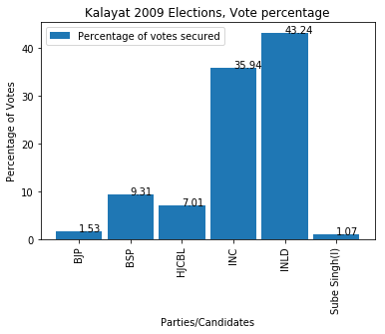
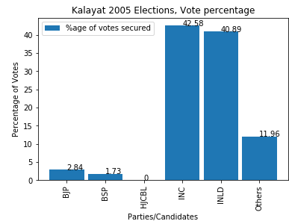
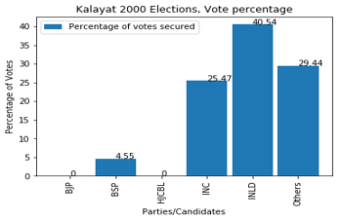

Slide 9
Conclusion
Floating vote share is more than 30%, means that there is lack of very strong voter’s base and voting patterns can elections can be influenced
INLD (Indian National Lok Dal) has a great influence in voting percentage in all 3 constituencies.
The candidate should be from similar caste, (‘Singh’) that forms the majority of population.

Slide 10
Developed Using
Language: Python
Tools: Anaconda, Jupyter Notebook, IDLE, Adobe Acrobat
Library: Pandas, NumPy, Matplotlib, Scikit- Learn
API: For Data Wrangling- 'pdftables-api'

Slide 11
Thank You!!
By Pranjal Rastogi

